Slide 1
SmartInn
digital
Fingers

Slide 2

Design and Process on

Slide 3
1b
Brief description
SmartInn got more than 200 locations that spread across North America and Asia. They have a website that contains a daily blog and social integration service initiative which shows customer reviews on the quality of SmartInn’s services
Main features
● Responsive website with blog (multiple language support)
● Revision management enabled for service deployments
● Multiple language support for website
● Translation of customer reviews
● Increased velocity of service deployments
● New revision retains existing level of operational stability by deployment to a reduced user base
Roles of typical user
● Customer ● Developer lead ● Marketing lead
● Ops lead ● Product lead
SmartInn

Slide 4
2a
User personas
Christy
Christy is a busy Site Engineer who likes to fully utilize the time at her disposal, she prefer to order food via online for herself and workers, often booked at specific times in a day. Customer feedback play a major role in the choice Christy makes. Christy likes to perform all operations from her phone
SmartInn

Slide 5
2a
User personas
Sam
Sam is a student who likes to travel home to visit parents and also takes vacations
twice yearly. His primary concern is cost, and he will always book the lowest price travel
regardless of convenience. Sam has no loyalty and will use whichever retailer can
provide the best deal.
SmartInn

Slide 6
2b
User stories
Website remains responsive
As a product lead, I want to ensure the website remains responsive, so that customers face minimal wait times
SmartInn

Slide 7
2b
User stories
Velocity of deployments
As a developer lead, I want to increase the velocity of service deployments.
SmartInn

Slide 8
2b
User stories
System performance
As an ops lead, I want to ensure system stability is observed, so the system performance is not degraded through the deployment of new revisions.
SmartInn

Slide 9
2b
User stories
Translation of reviews
As a manager, I want to ensure customers’ reviews are translated, so that I can understand their pain point, server them better and build loyalty
SmartInn

Slide 10
2b
User stories
Website support multi-languages
As a marketing lead, I want to ensure the website supports at least three languages, so that we can gain more visitors and blog readers and enhance our publicity
SmartInn

Slide 11
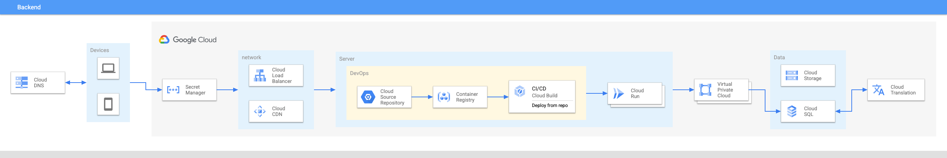
3
Architecture Overview
SmartInn

Slide 12
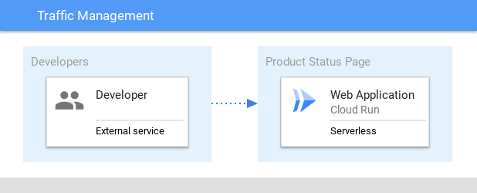
4
MVP Architecture
In the proposed solution, the product service is used to demonstrate how traffic migration and revision tagging can be used with Cloud Run.
SmartInn

Slide 13
4
Definition of Done
Ref | Definition of Done
1 | User base are not impacted by the rollout of new features
2 | Revision management enabled for service deployments
3 | New revision retains existing level of operational stability by deployment to a reduced user base
SmartInn

Slide 14
4
Traffic migration versus revision tags
SmartInn

Slide 15
4
Developing a minimal viable product (MVP)
To build an MVP the following activities are required:
Configure the environment
Test Revision Tags
Test Traffic Migration
Deploy a public service
SmartInn

Slide 16
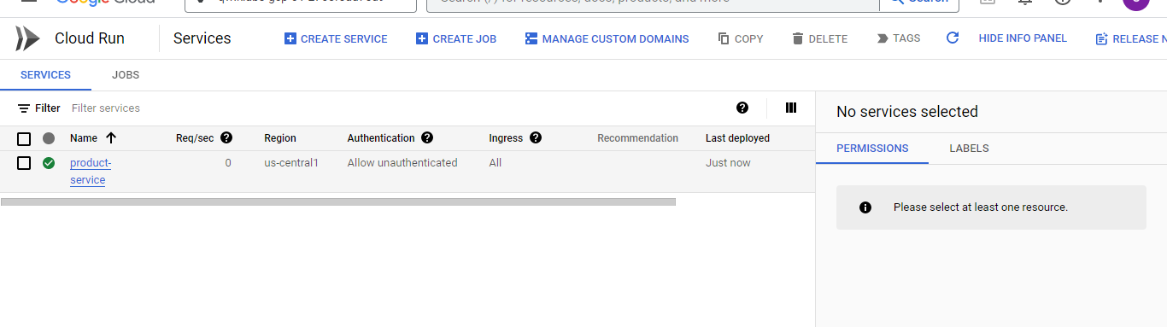
4
Configure the environment
SmartInn

Slide 17
4
Revision tags
Each new Cloud Run revision can be assigned a tag. Doing this allows access to a URL without serving traffic. An approach like this can be useful to handle the traffic profile across multiple revisions
The main uses cases for revision tags are shown in the following table:
Use Case
Description
Integration testing
Run containers revisions during the development
Tagged revision migration
Migrate traffic to a tagged revision
Tagged revision rollback
Rollback to prior version based on tagged revision
SmartInn

Slide 18
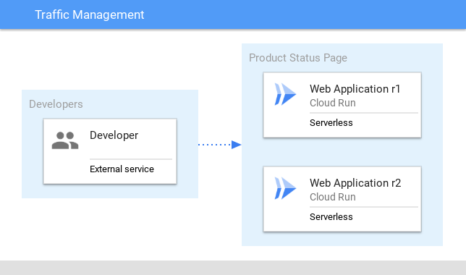
4
Revised architecture
SmartInn

Slide 19
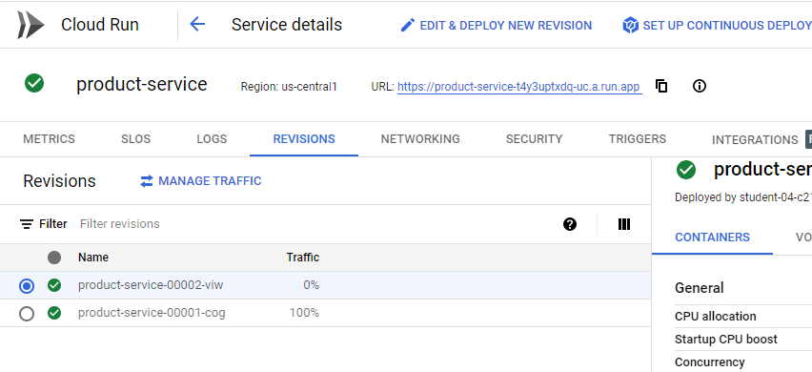
4
Integration testing
Cloud Run provides the ability to deploy a new revision with redirecting traffic. A deployment of this kind is useful
for integration testing of components.
SmartInn

Slide 20
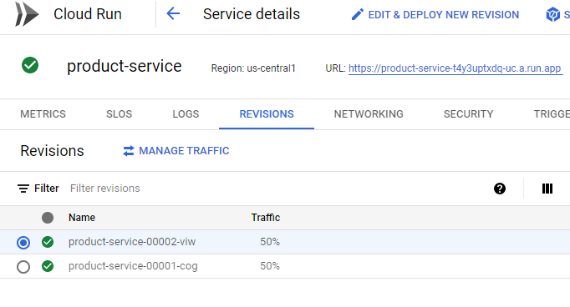
4
Revision migration
Deployed revisions to share the traffic profile. Migrated 50% of the traffic to the revision tag
SmartInn

Slide 21
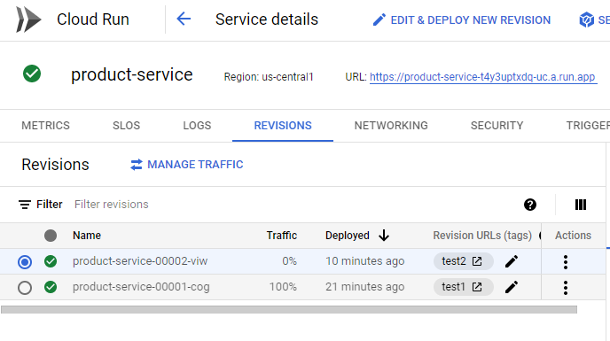
4
Tagged revision rollback
In the event an issue is found, the traffic migration can be rolled back by resetting the percentage.
SmartInn

Slide 22
4
Traffic migration
Migration of traffic provides a simple mechanism on which to direct communication to a deployed service.
Cloud Run provides the ability to have multiple revisions to be deployed without a cost penalty.
Cloud Run only charges where traffic is handled by the service.
SmartInn

Slide 23
4
The main use cases for traffic migration are shown in the following table:
SmartInn

Slide 24
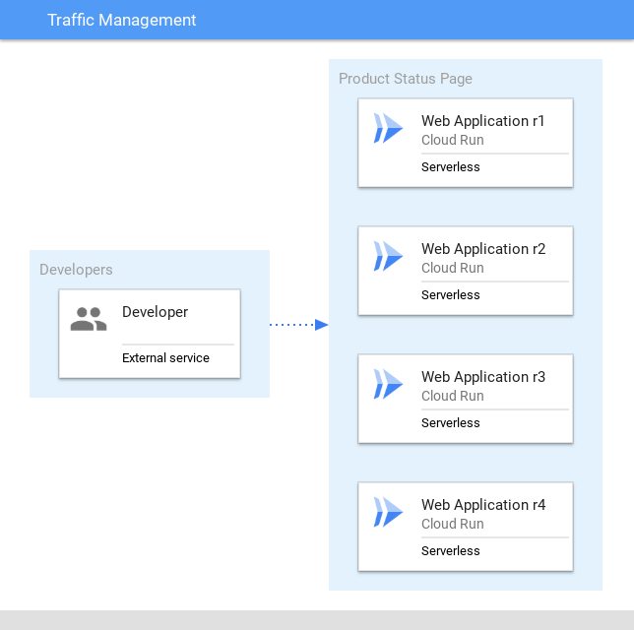
4
Revised architecture
SmartInn

Slide 25
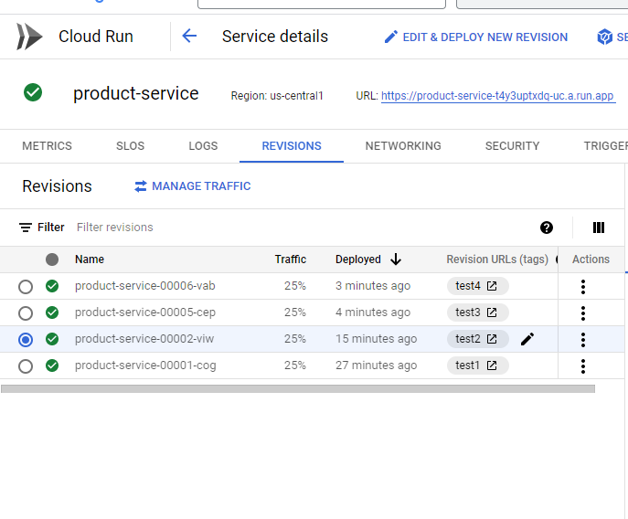
4
Traffic migration - deploy a new version
SmartInn

Slide 26
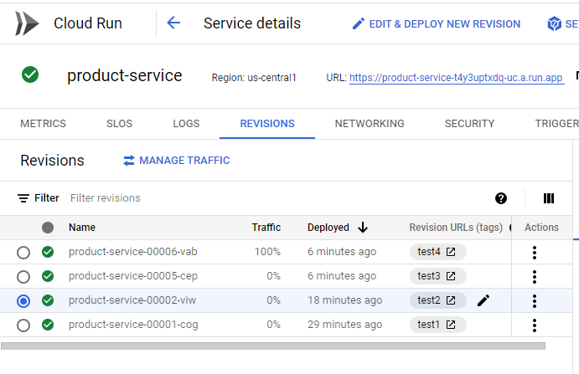
4
Traffic splitting - updated traffic between revisions
After reset, the service traffic profile now use the latest deployment as seen below:
SmartInn
The solution now take advantage of Cloud Run traffic management.

Slide 27
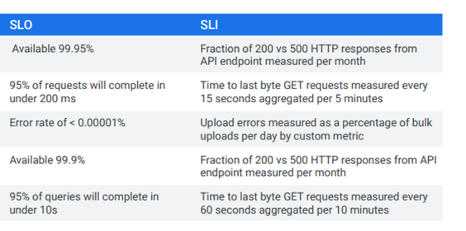
5
Defining SLIs and SLOs
SmartInn

Slide 28
5
- The SLI describes what we are going to measure and how:
for example, the “Fraction of 200 vs 500 HTTP responses from API endpoint
measured per month.” This example is a way of measuring availability.
- The SLO represents the goal we are trying to achieve for a given SLI.
For example, “Available 99.95%” of the time.”
SmartInn

Slide 29
digital
Fingers
“Customer centric and reliable infrastructure design”.
THANK YOU

